Slide 1
PRO2000 - programming
Week 34
Gebremariam Assres
Gebremariam.assres@kristiania.no
Notes:
Associate Professor, Kristiania University of Applied Sciences
Faculty of health and technology
The subjects I currently teach:
C++ Programming, Databases, Machine Learning, Software architecture.
My qualifications & background:
B.Sc./M.Sc. in Computer Science
Ph.D. in Information Technology (software engineering)
Worked as lecturer, assistant professor, and research fellow (teaching and research in various institutions including Brunel Univeristy London)
Taught various courses (operating systems, distributed systems, AI, machine learning, Java programming, databases, etc.)

Slide 2
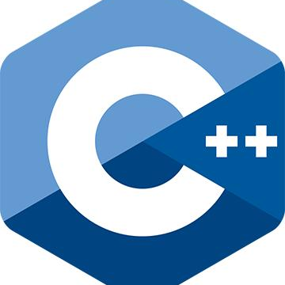
Welcome to the course ☺

Slide 3
Today's topics
Introduction to the course
Overview of C++
  C++ programming environments

Slide 4
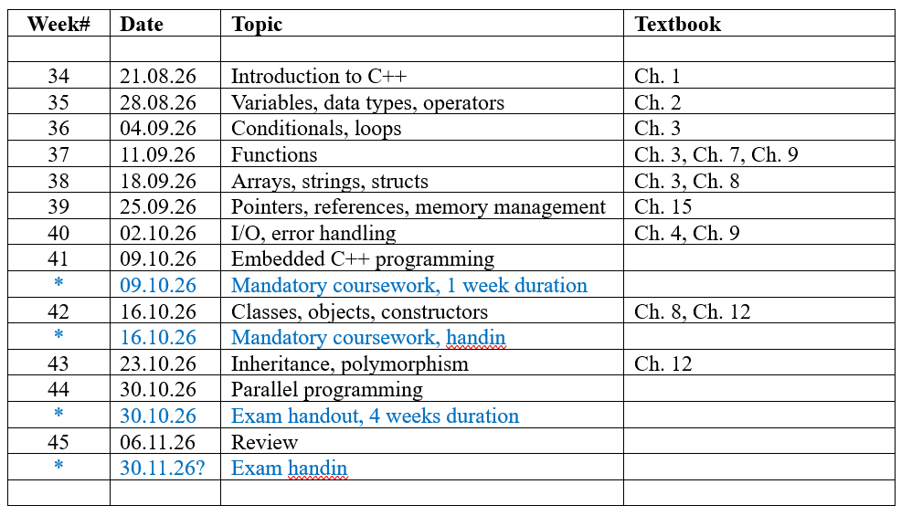
Lesson structure

Slide 5
Resources
Textbook:
  Stroustrup, Bjarne. Programming: principles and practice using C++. Third edition., Hoboken, New Jersey, Addison-Wesley, 2024
Other references:
  Viarheichyk, I. (2020). Embedded Programming with Modern C++ Cookbook: Practical recipes to help you build robust and secure embedded applications on Linux. Packt Publishing Ltd.
  Voss, M., Asenjo, R., & Reinders, J. (2019). Pro TBB: C++ parallel programming with threading building blocks (pp. 25-26). New York: Apress.
  Malik, D. S. (2006). C++ Programming: From problem analysis to program design. Evaluation, 70(10), 20.
  Deitel, Paul J, and Harvey M Deitel. C++: How to Program. Ninth edition. Boston: Pearson Education, 2014. Print.
  Will, Torsten T. C++: The Comprehensive Guide. 1st edition. Bonn: Rheinwerk Publishing, 2025. Print.
  Deitel, Paul J, and Harvey M Deitel. C++ How to Program: Introducing the New C++ 14 Standard. Tenth edition. Hoboken, New Jersey: Pearson Education, 2017. Print.

Slide 6
Study guide
We have 12 lessons, always on Fridays.
  Lectures at 10:15 to 12:00. Exercises at 12:15 to 14:00.
It takes more than 4 hours a week (the time we share) to learn C++ programming!
  As a rule of thumb, match every hour with a teacher with an hour on your own.
  In other words, aim for 8 hours total per week. (4 hours with me, 4 on your own.)
My suggestion:
  Start a study-group with some of your fellow students! :-)
  Agree on some weekdays and timeslots to meet and work together.
  For example: Work 2 hours after the exercises + 2 more hours before next Friday.
And remember: Invite others to join you. Take care of each other! :-)

Slide 7
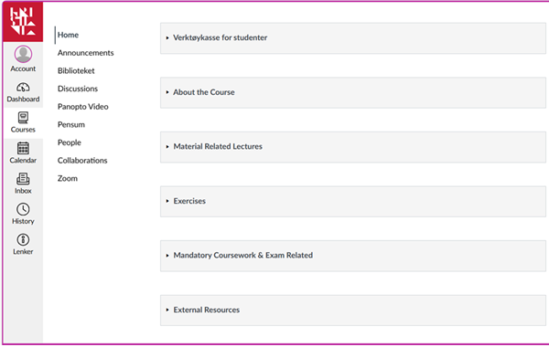
Canvas – our learning platform
See Canvas for:
  Subject description
  Lesson structure
  Lecturing material
  Exercises
  External resources
Examination:
  Portfolio
  Exam graded A-F

Slide 8
How to participate in my lectures
A few things I want to mention, so we all get a good experience:
When you meet up for a lecture, pay attention!
  Don't check YouTube, ChatGPT, Facebook or do other non-relevant PC-activity. (It's of course ok to do so in the breaks.)
  Do NOT try to sleep in class!
Why these rules?
  Out of respect for your fellow students!
  (And of respect for me – but most importantly, your fellow students!)

Slide 9
Overview of C++

Slide 10
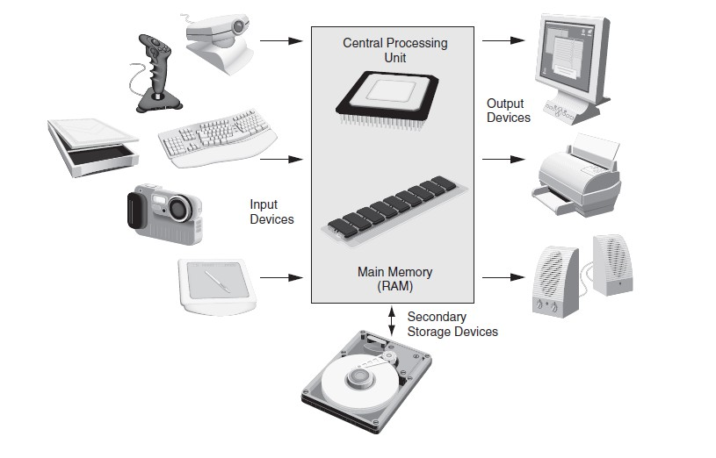
Computer Systems = Hardware + Software
Hardware – Physical components of a computer and main categories include:
  Central Processing Unit (CPU)
  Main memory (RAM)
  Secondary storage devices
  Input Devices
  Output Devices

Slide 11
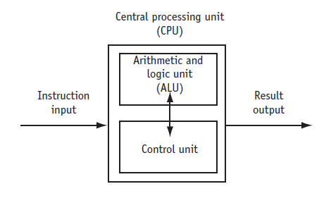
Computer Systems …
CPU – Hardware component that runs programs that includes:
  Control Unit
    Retrieves and decodes program instructions
    Coordinates computer operations
  Arithmetic & Logic Unit (ALU)
    Performs mathematical operations

Slide 12
Computer Systems …
The CPU’s role in running a program:
  Iterates through fetch, decode and execute
  Fetch: get the next program instruction from main memory
  Decode: interpret the instruction and generate a signal
  Execute: route the signal to the appropriate component to perform an operation

Slide 13
Computer Systems …
System software - programs that manage the computer hardware and the programs that run on the computer
  Operating Systems
    Controls operation of computer
    Manages connected devices
    Runs programs
  Utility Programs
    Support programs that enhance computer operations
    Examples: anti-virus software, data backup, data compression
  Software development tools
    Used by programmers to create software
    Examples: compilers, integrated development environments (IDEs)

Slide 14
Computer Systems …
Definitions:
  Program is a set of instructions directing a computer to perform a task
  Programming Language a language used to write programs
  Algorithm - a set of steps to perform a task or to solve a problem. Order is important so steps must be performed sequentially
  Types of languages:
    Low-level - used for communication with computer hardware directly.
    High-level - closer to human language

Slide 15
Computer Systems …
Compilation and linking
  You write C++ source code - Source code is (in principle) human readable
  The compiler translates what you wrote into object code (sometimes called machine code which is simple enough for a computer to “understand”)
  The linker links your code to system code needed to execute (E.g., input/output libraries, operating system code, and windowing code)
  The result is an executable program (E.g., a .exe file on windows or an a.out file on Unix)
C++ compiler
C++ source code
Object code
Executable program
linker
Library Object code

Slide 16
Computer Systems …
The preprocessor
#include
Inserts file contents verbatim
Before Preprocessing
#include <vector>
#include "mylib.h"
#define PI 3.14159
float area = PI * r * r;
#define
Text substitution macros
#define MAX_SIZE 256
#define SQ(x) ((x)*(x))
After Preprocessing
// #define removed (macro replaced)
float area = 3.14159 * r * r;
#ifdef
Conditional compilation
#ifdef DEBUG
log(msg);
#endif
Modern C++ Tip: Prefer constexpr over #define for type safety.
#pragma
Compiler-specific hints
#pragma once
#pragma pack(1)
Notes:
Preprocessor runs completely BEFORE the compiler sees the code.
#include guard pattern: use #pragma once or the classic #ifndef MYHEADER_H trick.
Macros are dangerous: no type checking, no scope, hard to debug (show up in error messages as expanded form).
constexpr (C++11) replaces most #define constants with type-safe equivalents.
Inline functions replace most function-like macros.

Slide 17
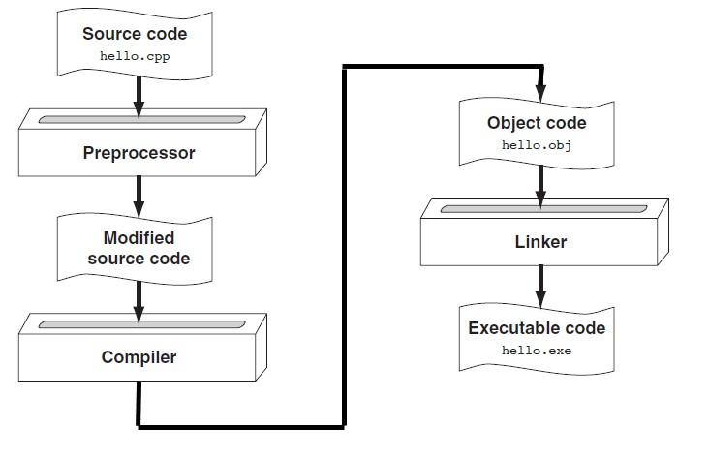
Computer Systems …

Slide 18
C++ programming
A programming language allows to express your ideas in code
You can’t learn to program without a programming language
C++ is the programming language that most directly allows you to express ideas from the largest number of application areas
C++ is the most widely used language in engineering areas (http://www.stroustrup.com/applications.html)

Slide 19
C++ programming …
C++ is defined by an ISO standard
    And that standard is almost universally accepted
    The most recent C++ standard is C++23 (officially published as ISO/IEC 14882:2024)
C++ is available on almost all kinds of computers
Programming concepts that you learn using C++ can be used fairly directly in other languages
    Including C, Java, C#, and (less directly) Fortran

Slide 20
C++ programming …
1979
1998
2011
2017
2023
C with Classes (C was created by Dennis Ritchie in 1972)
C++98
C++11 ★
C++17
C++23
STL, templates
auto, lambdas, move
std::optional, if constexpr
std::print, ranges
1985
2003
2014
2020
C++ 1.0
C++03
C++14
C++20
Virtual functions
Stability
Generic lambdas
Concepts, coroutines, modules
Notes:
Emphasize the 3-year release cycle since C++11. ISO committee publishes on a schedule, not when it's 'done'.
C++98/03 is 'legacy C++', often found in large codebases (automotive, aerospace).
C++11 is the practical minimum for new projects. Many embedded toolchains support C++17 now.
Ask: what standard does your workplace/school compiler target?

Slide 21
C++ programming …
Our civilization runs on software
  Most engineering activities involve software
Note: most programs do not run on things that look like a PC
  a screen, a keyboard, a box under the table
There’s a lot more to computing than games, word processing, browsing, and spreadsheets!

Slide 22
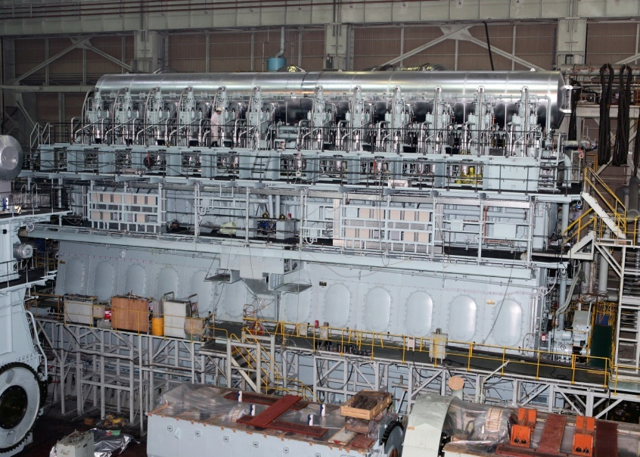


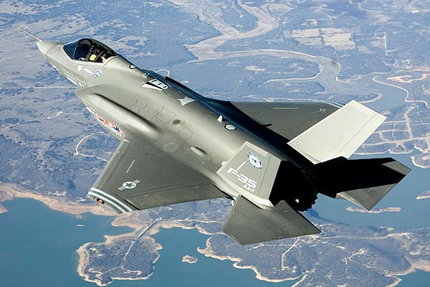

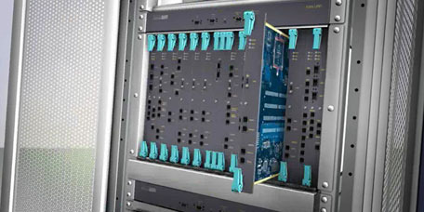
Design
Construction
Management
Monitoring
Engine
Hull design
Pumps
Ships
Signal processing
“Gadget” control
Monitoring
Aircraft
Communication
Control
Display
Phones
Switching
Reliability
Provisioning
Images
Voice quality
User interfaces
Billing
Mobility
Notes:
Versatile

Slide 23




C++ programming …
General-Purpose
High Performance
Systems-Level
Portable
Multi-paradigm: procedural, object-oriented, generic, and functional styles.
Zero-overhead abstractions, deterministic memory, inline assembly support.
Direct hardware access, bit manipulation, memory-mapped I/O.
Write once, compile everywhere — from microcontrollers to supercomputers.

Slide 24
Programming environments & first C++ program

Slide 25
C++ programming environments
Required software
  Visual Studio Code - Source code editor
  MinGW-w64 - C++ Compiler (g++)
  gdb – gnu debugger
  Microsoft C/C++ Extension - IntelliSense and Debugging
  Read the “Setup Guide VS Code for C++ with MinGW g++, gdb on Windows”

Slide 26
C++ programming environments …
The setup guide enables to:
  Install Visual Studio Code
  Install MinGW-w64 (g++ and gdb)
  Configure Visual Studio Code
  Build, Debug and Troubleshooting

Slide 27
A first program- Hello, World!
Common elements of a program
  Key Words
  Programmer-Defined Identifiers
  Operators
  Punctuation
  Syntax- set of rules that defines how symbols, keywords, and punctuation must be ordered to write valid code.

Slide 28
A first program- Hello, World!
“Hello world” is a very important program
  Its purpose is to help you get used to your tools
    Compiler
    Program development environment
    Program execution environment
  Type in the program carefully
    After you get it to work, please make a few mistakes to see how the tools respond.
    For example,
      Forget the header
      Forget to terminate the string
      Misspell return (e.g., retrun)
      Forget a semicolon
      Forget { or }
      …

Slide 29
CODE
A first program- Hello, World!
#include
Preprocessor directive. Inserts iostream header before compilation.
// Include the standard I/O stream library
#include <iostream>
using
Brings std namespace into scope. Avoid in headers — causes namespace pollution.
// using directive — avoids std:: prefix
using namespace std;
int main()
OS calls main() to start your program. Returns int (0 = success).
// Entry point — program starts here
int main() {
cout
cout << "Hello, World!" << endl;
std::cout is the standard output stream object (console).
return 0;
endl
}
Flushes buffer and inserts newline. Use '\n' for performance.
Notes:
Walk through each line. Key teaching moments:
1. Preprocessor runs BEFORE the compiler — it's a text substitution tool.
2. 'using namespace std' is convenient but dangerous in large projects.
3. main() is special — it's the only function the runtime calls directly.
4. cout uses the << (stream insertion) operator — operators are overloadable in C++.
5. endl vs \n: endl calls flush() — slower but ensures output appears immediately.

Slide 30
A first program- Hello, World!
// myHeaders.h
#include <iostream>
using namespace std;
// main.cpp
#include <myHeaders.h>
int main() {
cout << "Hello, World!" << endl;
return 0;
}
Notes:
Modularize your program – more on this to come

Slide 31
A first program- Hello, World!
Statement | Purpose
// My first C++ program | comment
#include <iostream> | preprocessor directive
using namespace std; | which namespace to use
int main() | beginning of function named main
{ | beginning of block for main
cout << "Hello, World!"; | output statement
return 0; | send 0 back to the operating system
} | end of block for main
Notes:
// “” quotes delimit a string literal
// NOTE: “smart” quotes “ ” will cause compiler problems. So make sure your quotes are of the style " "
// endl or \n is a notation for a new line
// note the semicolons; they terminate statements
// braces { … } group statements into a block
// main( ) is a function that takes no arguments ( )
// and returns an int (integer value) to indicate success or failure

Slide 32
Up next: Exercises
Now: 2 hours (12:15 to 14:00) of exercises (found on Canvas).
Short exercise summary:
  Write, compile, and debug a C++ program from scratch
  (If you haven't already: Install VS Code, Install g++, Install gdb!)
Remember:
  You should do approximately 4 more hours of the course (in a study group or alone) before our next session together. :-)

